Slide 1
Python
Bootcamp 2023

Slide 2
Outline for today
Setup Anaconda
Running Python
Variables and Assignment
Data Type
Built-in functions
Conditionals
Loops

Slide 3
Outline for today
Setup Anaconda
Running Python
Variables and Assignment
Data Type
Built-in functions
Conditionals
Loops

Slide 4
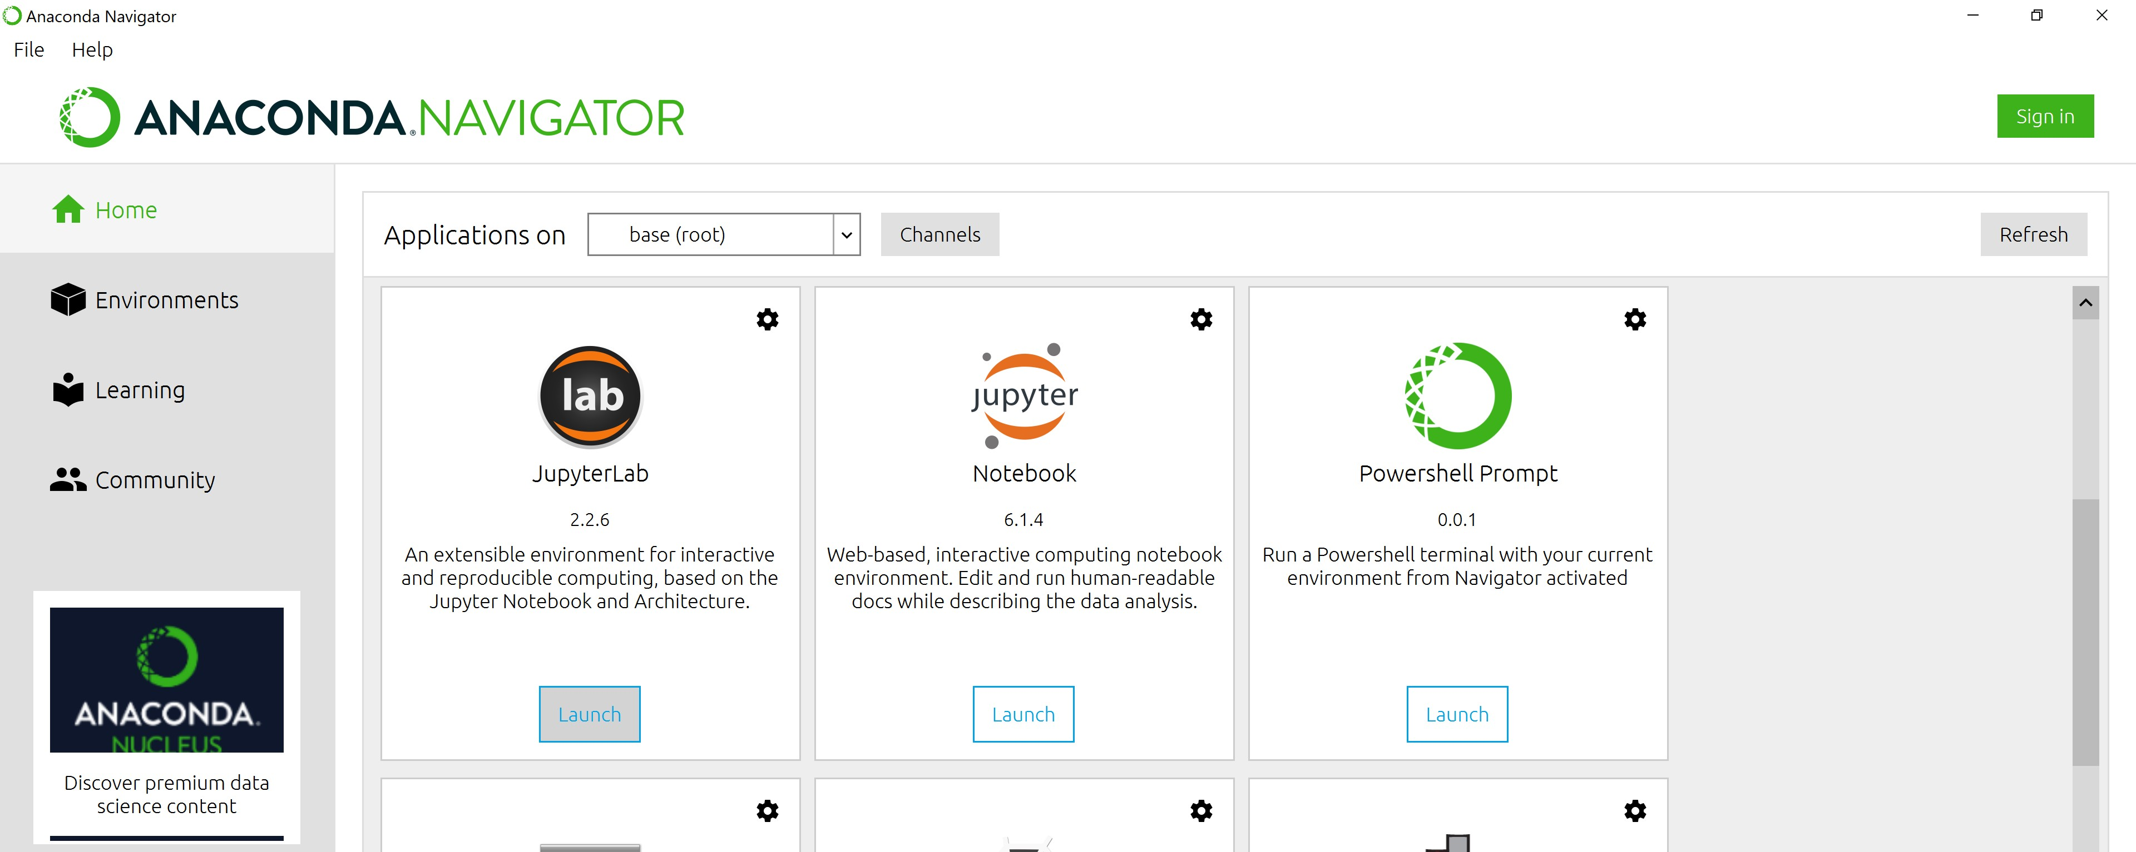
Setup Anaconda

Slide 5
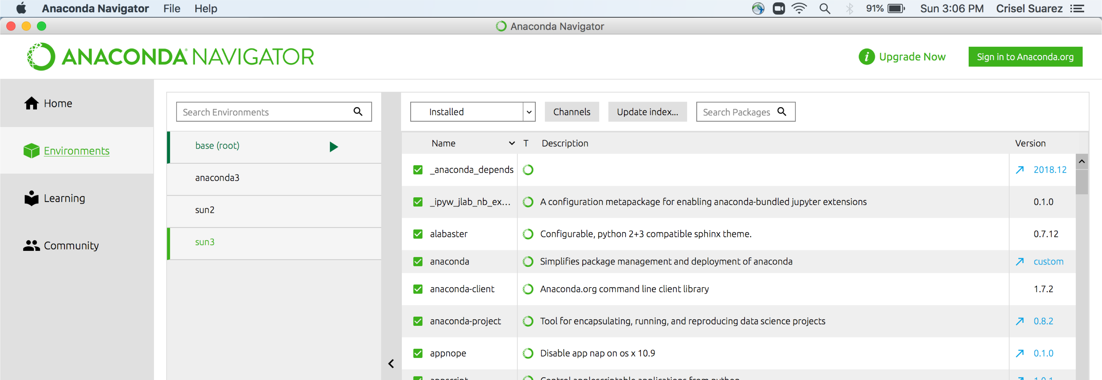
Setup Anaconda

Slide 6
Setup Anaconda
>On your bash shell
$ conda create –name bootcamp2021
proceed ([y]/n)?
Y
$ conda info --envs
$ conda env list
$ conda activate bootcamp2021
$ conda list -n bootcamp2021
$ conda deactivate
$ conda install package-name
$ conda install package-name=2.3.4
https://conda.io/projects/conda/en/latest/user- guide/tasks/manage-environments.html
https://docs.anaconda.com/anaconda/user- guide/tasks/install-packages/
$ conda –-version
$ conda update conda
this can take awhile!

Slide 7
Scripts /Spyder/Jupyter Notebook/JupyterLab
All have pros/cons
Choose what works best for you
It is okay to switch between platforms

Slide 8
Python Scripts
Run scripts on your bash shell
$python
>>>
>>>print(‘hello world’)
>>>exit() #Go back to your bash shell ($)
$ vim hello_world.py
print(‘hello world’)
$python hello_world.py
vim
Insert mode (i)
Type your script/notes
esc
:wq

Slide 9
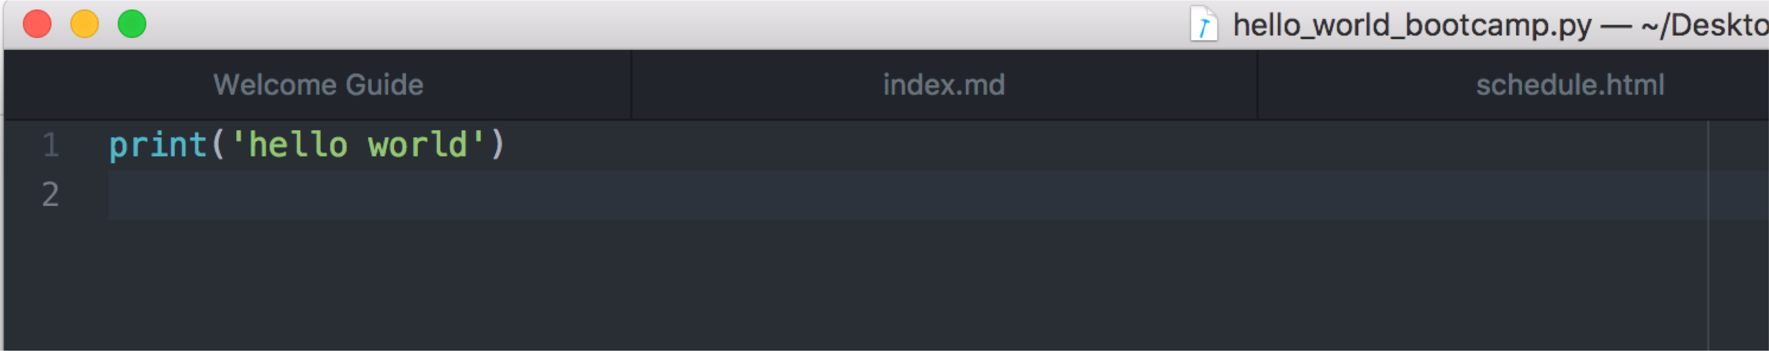
Python Scripts-Atom/Text Editor
On your bash shell
$python hello_world_bootcamp.py hello world

Slide 10
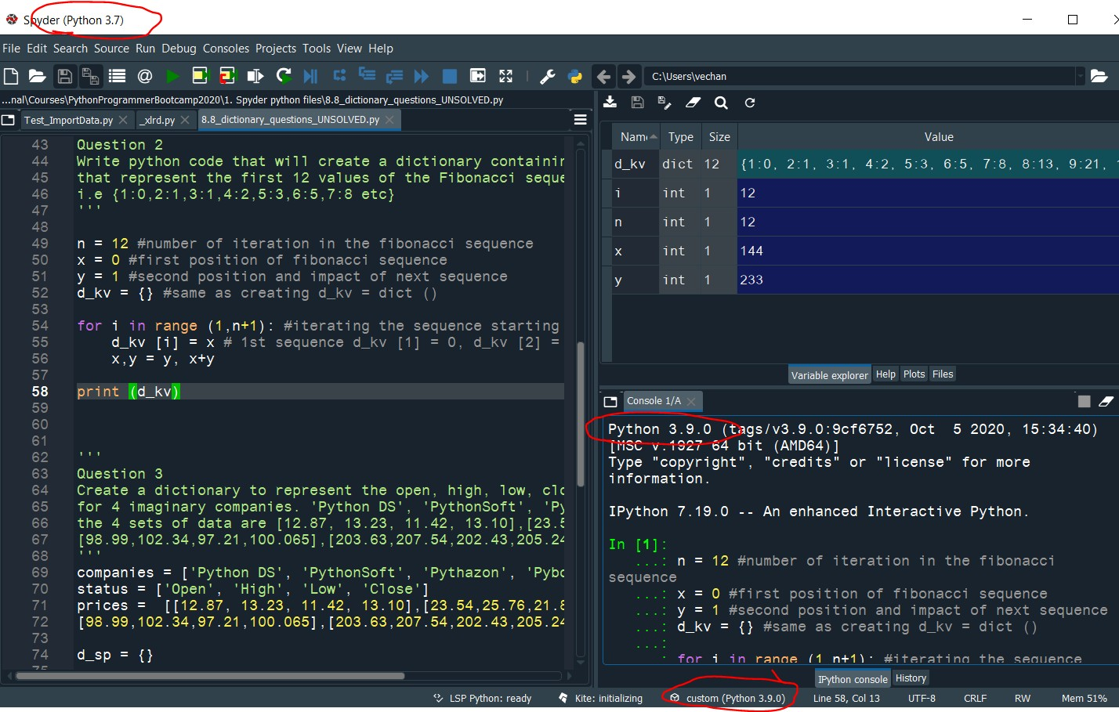
Spyder
Declared Variables
Script Code goes here
Output

Slide 11
Spyder
Run your code

Slide 12
Spyder
Debug your code
More on this later

Slide 13
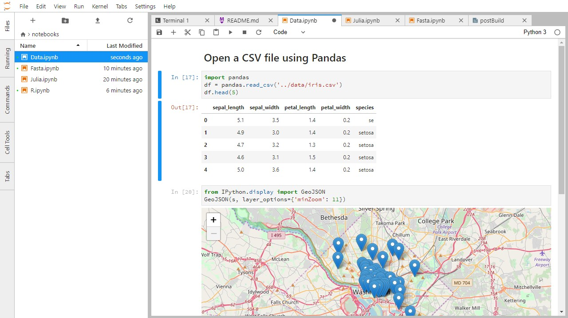
Jupyter Lab (.ipynb)
$ jupyter lab
Cell – Code
Output
To run a cell: shift + enter
https://jupyterlab.readthedocs.io/en/stable/user/notebook.html

Slide 14
$ jupyter notebook
Jupyter notebook (.ipynb)
When in Command mode (esc/gray),
The b key will make a new cell below the currently selected cell.
The a key will make one above.
The x key will delete the current cell.
The z key will undo your last cell operation (which could be a deletion, creation, etc).
https://jupyter-notebook.readthedocs.io/en/latest/notebook.html

Slide 15
Jupyter notebook (.ipynb)
Markdown great for commenting/adding notes to your code!
A simple plain-text format for writing lists, links, and other things that might go into a web page.
Turn the current cell into a Markdown cell by entering the Command mode (Esc) and press the M key.
In [ ]: will disappear to show it is no longer a code cell and you will be able to write in Markdown.
Turn the current cell into a Code cell by entering the Command mode (Esc) and press the y key

Slide 16
Markdown – html
Use asterisks
to create
bullet lists.
Lists
# A Level-1 Heading
## A Level-2 Heading (etc.)
Headings
[Create links](http://software-carpentry.org) with `[...](...)`.
urls + links
Or use [named links][data_carpentry]. [data_carpentry]:
http://datacarpentry.org

Slide 17
Outline for today
Setup Anaconda
Running Python
Variables and Assignment
Data Type
Built-in functions
Packages
Conditionals
Loops

Slide 18
Variables and Assignments
In Python the = symbol assigns the value on the right to the name on the left
age = 42
my_name = ‘your name’
Grade1 = ‘A’
Variable names
can only contain letters, digits, and underscore _
cannot start with a digit
are case sensitive (age, Age and AGE are three different variables)

Slide 19
Variables and Assignments
first_name = ‘Kathy ’
age = 10
print(first_name, 'is', age, 'years old’)
Variables can be used in calculations:
new_age = age +10
Indexing
print(first_name[0])
*** Python indexing starts at 0 ***

Slide 20
Outline Friday
Jupyter Magic Commands
Data types
Indexing and Slices
Lists
Built-in Functions
Data type
Conditionals
Loops
Functions

Slide 21
Key Points
Use variables to store values.
Use print() to display values.
Variables persist between cells.
Variables must be created before they are used.
Variables can be used in calculations.

Slide 22
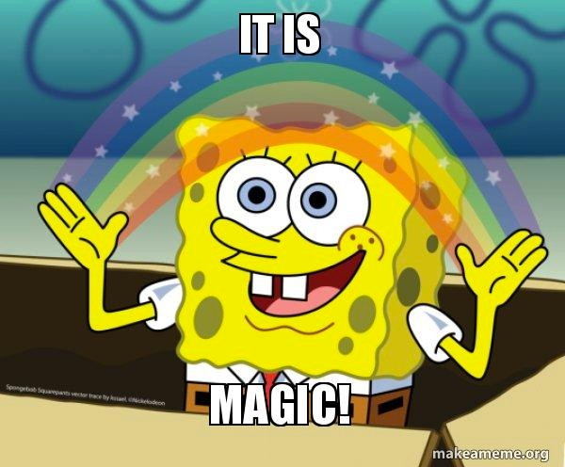
Jupyter Magic Commands
%run hello.py # runs script
%time # times run
% who
%who str | % who int
%pinfo <variable>
%env
%matplotlib inline
%load hello.py
%lsmagic
https://www.tutorialspoint.com/jupyter/ipython_magic_commands.htm

Slide 23
Jupyter Magic Commands
Can run Unix commands straight from your Jupyter Notebooks
!
!head –n 5 haiku.txt
!pip install astropy
Almost all the things we learned in Unix we can use in Jupyter Notebooks

Slide 24
Data Types
str() – String
Concatenation +
Repetition *
int()- integer
Float() - decimals
Type() > What kind of data type

Slide 25
Math
Add +
Subtract -
Multiply *
Divide /
Power **
Reminder %
Absolute value abs()

Slide 26
Operators
Equal to ==
Not equal to !=
Greater than >
Less than <
Greater or equal >=
Less or equal <=

Slide 27
Operators
and
or
in (Membership)
not in (Membership)
True
False

Slide 28
Outline Friday
Jupyter Magic Commands
Data types
Indexing and Slices
Lists
Built-in Functions
Conditionals
Loops
Functions

Slide 29
Indexing and Slices
[start:stop]
atom_name = 'sodium’
print(atom_name[0:3])
> sod
len(atom_name)
6

Slide 30
Outline Friday
Jupyter Magic Commands
Indexing and Slices
Lists
Built-in Functions
Conditionals
Loops
Functions

Slide 31
Lists
Storing multiple variables
pressures = [0.273, 0.275, 0.277, 0.275, 0.276]
print('pressures:', pressures)
print('length:', len(pressures))
print('zeroth item of pressures:', pressures[0])
pressures[0] = 0.265
•

Slide 32
Lists – Appending
list_name.append()
primes = [2, 3, 5]
print('primes is initially:', primes)
primes.append(7)
print('primes has become:', primes)

Slide 33
Lists – Deleting
del list_name[index] to remove an element from a list
primes = [2, 3, 5, 7, 9]
print('primes before removing last item:', primes)
del primes[4]
print('primes after removing last item:', primes)

Slide 34
List- Empty []
Empty_list = []
Helpful as a starting point for collecting values

Slide 35
Practice:
print('string to list:', list('tin’))
print('list to string:’, “ ”.join(['g', 'o', 'l', 'd’]))
What does list do? What does .join do?
*We will come back to list with Numpy’s version …arrays

Slide 36
Key Points
Use an index to get a single character from a string.
Use a slice to get a substring.
Use the built-in function len() to find the length of a string.
Python is case-sensitive.
Use meaningful variable names

Slide 37
Dictionaries {} or dict()
Mutable key-value pairs
zoo = {‘cats’ : 4 , ‘dogs’: 5, ‘goats’: 3, ‘camels’ : 2 }
person = dict(name = "John", age = 36, country = "Norway")
zoo[‘cats’]
> 4
zoo.keys()
zoo.values()
zoo.items()

Slide 38
Dictionaries
food = {‘breakfast’ : 2 , ‘lunch’: ‘salad’, ‘dinner’: {‘first_course’ : ‘soup’,
‘second_course’: ‘chicken’ },
'dessert' : [‘flan’, ’cookies’, ‘NY_cheesecakes’]}
food['dinner']['first_course’]
food['dessert'][0]

Slide 39
Tuple – ()
Tuples are used to store multiple items in a single variable.
A tuple is a collection which is ordered and unchangeable.
Tuples are written with parentheses ()
Allows duplicated items
thistuple = ("apple", "banana", "cherry")
thistuple = ("apple", "banana", "cherry", "apple", "cherry")

Slide 40
Sets – {}
Unordered
Unchangeable
No duplicate values.
thistuple = {"apple", "banana", "cherry”}
thistuple = {"apple", "banana", "cherry", "apple", "cherry”}

Slide 41
Python Collections
List is a collection which is ordered and changeable. Allows duplicate members.
Tuple is a collection which is ordered and unchangeable. Allows duplicate members.
Set is a collection which is unordered and unindexed. No duplicate members.
Dictionary is a collection which is ordered* and changeable. No duplicate members.

Slide 42
Outline Friday
Jupyter Magic Commands
Indexing and Slices
Lists
Built-in Functions
Conditionals
Loops
Functions

Slide 43
Built-in functions
Think math function
f(x) = x + 5
x -> input
f(x) -> output
Functions can take 0 or many arguments
print()
f(x1, x2, x3,…) = x1+ x2+x3 +…..

Slide 44
Built-in functions
max(1,2,3)
min(5,6,7)
round(3.712, 1) #rounds to 1 decimal place
help(round)

Slide 45
Functions attached to objects are called methods
Methods have parentheses like functions, but come after the variable.
my_string = 'Hello world!' # creation of a string object
print(my_string.swapcase())
# calling the swapcase method on the my_string object

Slide 46
Outline Friday
Jupyter Magic Commands
Indexing and Slices
Lists
Built-in Functions
Conditionals
Loops
Functions

Slide 47
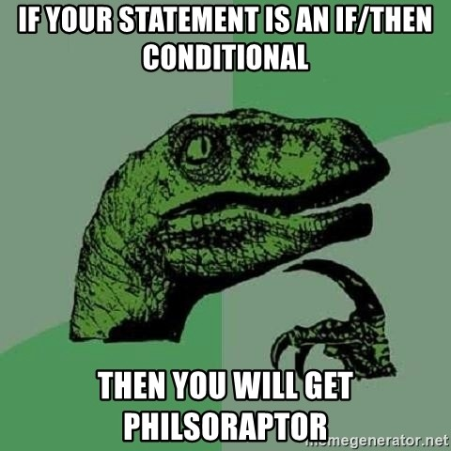
Conditionals
if (condition is True):
then do something
if (condition is True):
then do something
else:
Do something else
if (condition is True):
then do something
elif (this condition is true):
then do this
else:
Do this

Slide 48
Conditionals – Lets Practice
mass = 3.4.
If mass > 3.0:
print(‘Mass is ’ , mass)
if mass < 3.7:
print(‘mass less than 3.7’)
elif mass > 3.2 :
print(‘mass greater than 3.2’)
else:
print('mass greater than 3.7 or less than 3.2')
if mass > 3:
print(‘Mass is more than 3’)
else:
print(‘Mass is less than 3’)

Slide 49
Conditionals – Try it out
mass = 3.4
If ((mass < 3.7) and (mass >3.2)):
print('mass less than 3.7 and greater than 3.2')
mass = 3.4
If ((mass < 3.7) or (mass >3.2)):
print('mass less than 3.7 or greater than 3.2’)
mass = 3.8
If ((mass < 3.7) and (mass >3.2)):
print('mass less than 3.7 and greater than 3.2’)
mass = 3.8
If ((mass < 3.7) or (mass >3.2)):
print('mass less than 3.7 or greater than 3.2’)

Slide 50
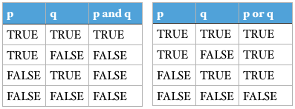
Conditionals

Slide 51
Outline Friday
Jupyter Magic Commands
Indexing and Slices
Lists
Built-in Functions
Conditionals
Loops
Functions
Potential point for in-class project

Slide 52
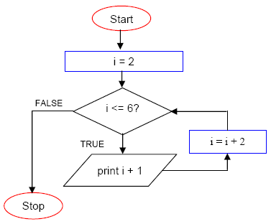
Loops
Loops are a programming construct which allow us to repeat a command or set of commands for each item in a list. As such they are key to productivity improvements through automation
i | i<= 6 | Output
2 | True | 3
4 | True | 5
6 | True | 7
8 | False

Slide 53
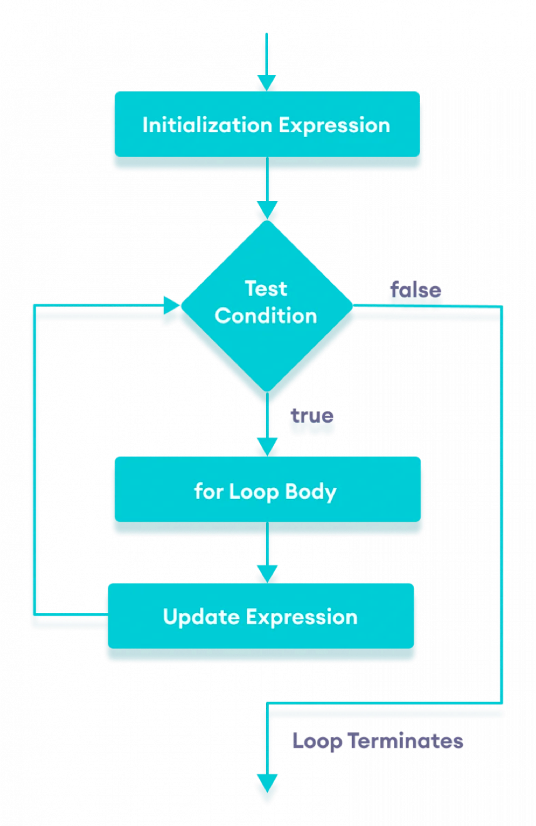
Loops
Loops are a programming construct which allow us to repeat a command or set of commands for each item in a list. As such they are key to productivity improvements through automation

Slide 54
Loops
for number in [2, 3, 5]:
print(number)
primes = [2, 3, 5]
for p in primes:
squared = p ** 2
cubed = p ** 3
print(p, squared, cubed)

Slide 55
Loops
The built-in function range produces a sequence of numbers.
Not a list: the numbers are produced on demand to make looping over large ranges more efficient.
print('a range is not a list: range(0, 3)’)
for number in range(0, 3):
print(number)

Slide 56
Loops – Practice
# List of word lengths: ["red", "green", "blue"] => [3, 5, 4]
lengths =
for word in ["red", "green", "blue"]:
lengths. ( )
print(lengths)

Slide 57
Loops – Practice
# List of word lengths: ["red", "green", "blue"] => [3, 5, 4]
lengths = []
for word in ["red", "green", "blue"]:
lengths.append(len(word))
print(lengths)

Slide 58
Loops – Practice
# Concatenate all words: ["red", "green", "blue"] => "redgreenblue”
words = ["red", "green", "blue"]
result =
for in :
print(result)

Slide 59
Loops – Practice
# Concatenate all words: ["red", "green", "blue"] => "redgreenblue”
words = ["red", "green", "blue"]
result = ””
for word in words:
result = result+word
print(result)

Slide 60
Practice
Write a program that prints the following pattern:
*
**
***
****
*****
******

Slide 61
Practice
Write a program that prints the following pattern:
for star in range(1,7): print(‘*’ * star)
*
**
***
****
*****
******
range(start, stop, step)

Slide 62
Calculator project

Slide 63
Outline- Monday
Loops (cont.)
Functions
Packages
Numpy
Pandas
Matplotlib
Mini Project

Slide 64
Practice
Write a program that prints the following pattern:
*
**
***
****
*****
******

Slide 65
Practice
Write a program that prints the following pattern:
for star in range(1,7): print('*’ * star)
*
**
***
****
*****
******

Slide 66
While Loops
Need to define an indexing variable***
i = 1
while i < 6:
print(i) i += 1
else:
print("i is no longer less than 6")
i = 1
while i < 6:
print(i) i += 1
***Loop can run forever***

Slide 67
Conditionals + Loops
i = 0
while i < 6:
i += 1
if i == 3:
print(”i is 3”)
print(i)
masses = [3.54, 2.07, 9.22, 1.86, 1.71]
for m in masses:
if m > 3.0:
print(m, 'is large’)
else:
print(m, ‘is small’)

Slide 68
Loops
continue - stop the current iteration, and continue with the next
fruits = ["apple", "banana", "cherry"]
for x in fruits:
if x == "banana":
continue print(x)
i = 0
while i < 6: i += 1
if i == 3:
continue print(i)

Slide 69
Loops
break - stop the loop even if the while condition is true
fruits = ["apple", "banana", "cherry"]
for x in fruits:
print(x)
if x == "banana": break
i = 1
while i < 6: print(i) if i == 3:
break i += 1

Slide 70
Loops
pass – ”Empty loop”
for x in [0, 1, 2]: pass

Slide 71
Nested Loops
persons = [ "John", "Marissa", "Pete", "Dayton" ] restaurants = [ "Japanese", "American", "Mexican", "French" ]
for person in persons:
for restaurant in restaurants: print(person + " eats " + restaurant)

Slide 72
Nested Conditionals
num = float(input("Enter a number: ")) if num >= 0:
if num == 0:
print("Zero")
else:
print("Positive number")
else:
print("Negative number")

Slide 73
Keypoints
Use if statements to control whether or not a block of code is executed.
Conditionals are often used inside loops.
Use else to execute a block of code when an if condition is not true.
Use elif to specify additional tests.
Create a table showing variables’ values to trace a program’s execution.

Slide 74
Keypoints
A for loop executes commands once for each value in a collection.
A for loop is made up of a collection, a loop variable, and a body.
The first line of the for loop must end with a colon, and the body must be indented.
Indentation is always meaningful in Python.
Make meaningful loop variables
The body of a loop can contain many statements.
Use range to iterate over a sequence of numbers.

Slide 75
Outline Wednesday
Jupyter Magic Commands
Indexing and Slices
Lists
Built-in Functions
Conditionals
Loops
Functions

Slide 76
Functions def()
***Functions return something
def print_greeting():
print('Hello!')
def print_date(year, month, day):
joined = str(year) + '/' + str(month) + '/’ + str(day)
print(joined)
def average(values):
if len(values) == 0:
return None
return sum(values) / len(values)

Slide 77
Practice
Fill in the blanks to create a function that takes a list of numbers as an argument and returns the first negative value in the list. What does your function do if the list is empty?
def first_negative(values):
for v in :
if :
return

Slide 78
Practice
Fill in the blanks to create a function that takes a list of numbers as an argument and returns the first negative value in the list. What does your function do if the list is empty?
def first_negative(values):
for v in values:
if v<0:
return v

Slide 79
Functions + Variable Scope
Global variable
Defined outside any particular function.
Visible everywhere.
pressure = 103.9
Local variable
Defined inside the function.
Not visible in the main program.
def adjust(t):
temperature = t * 1.43 / pressure
return temperature

Slide 80
Keypoints
Break programs down into functions to make them easier to understand.
Define a function using def with a name, parameters, and a block of code.
Defining a function does not run it.
Arguments in call are matched to parameters in definition.

Slide 81
END

